Slide 1

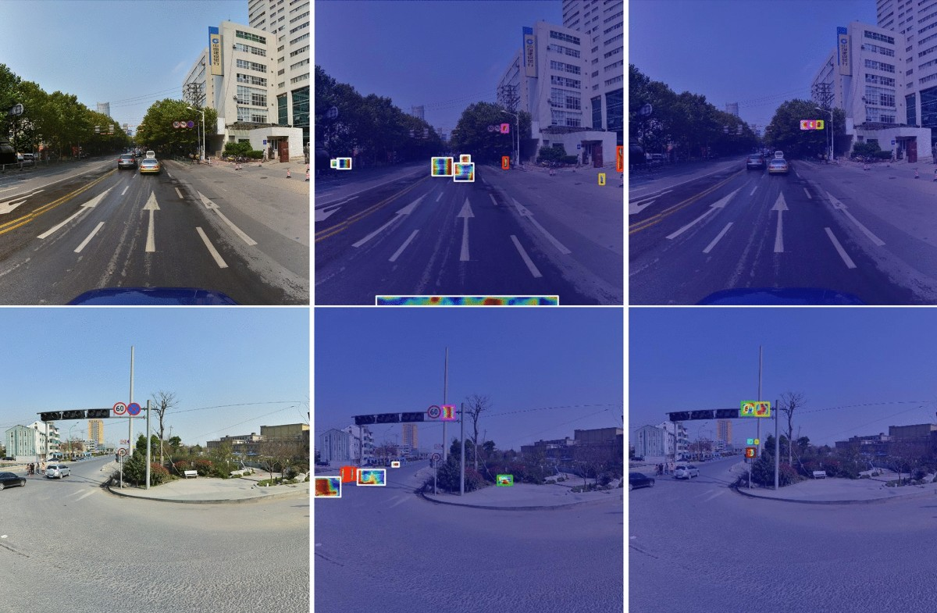
A Data-Centric Approach to High-Accuracy Traffic Sign Detection Using an Optimized YOLO v8 Model
Presented By-
Piyash Basak (221-35-993)
Supervisor:
Mr. Md Rajib Mia, Lecturer (Senior Scale)

Slide 2




Outlines
Research Gaps and Problem Statement
Objectives
Research Scope and Literature Review
Methodology
Dataset Overview
Results and Discussion
Comparison with State-of-Arts
Conclusion & Future Work

Slide 3
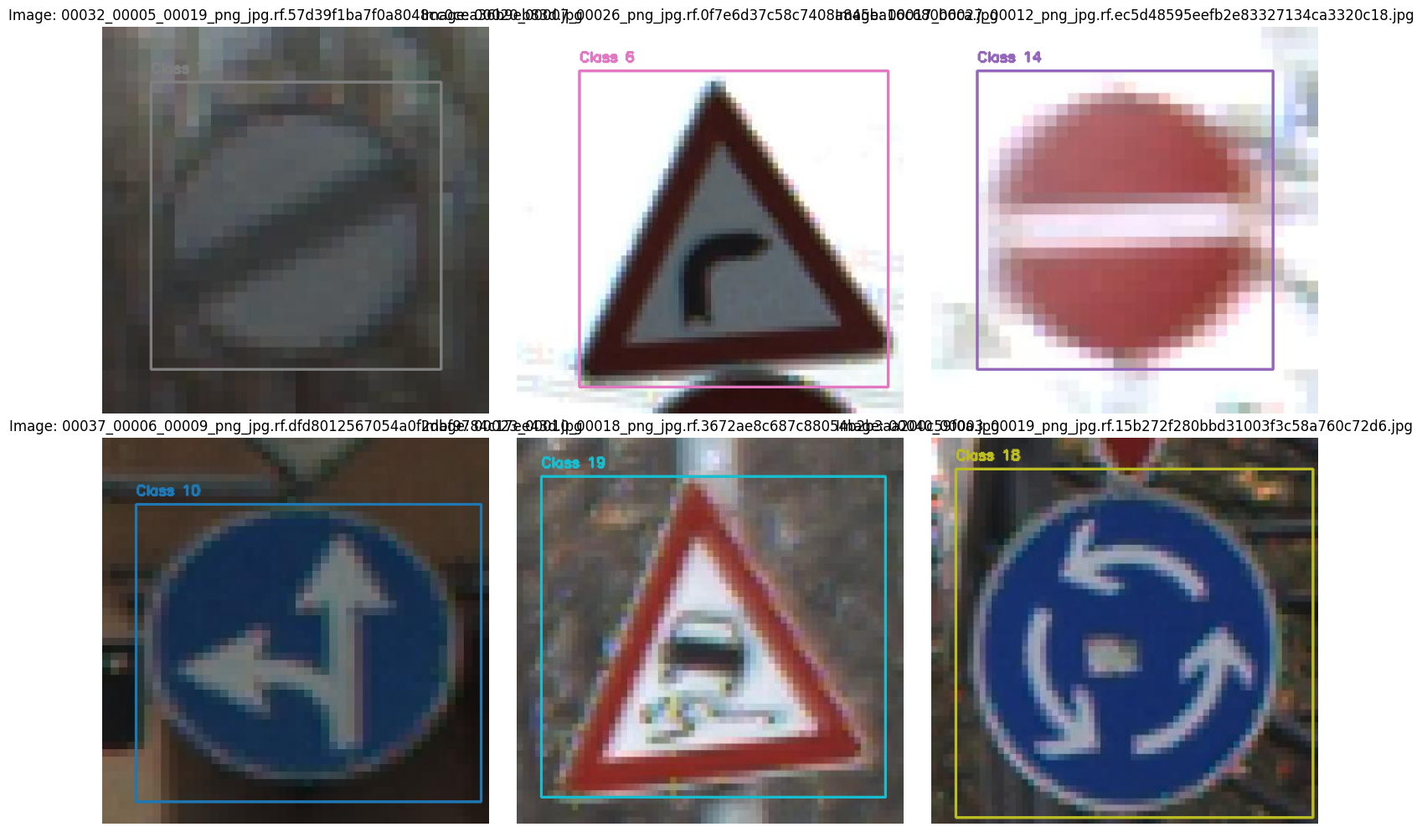
Problem Statement & Research Gaps
Problem Statement:
Traffic Sign Recognition (TSR) is critical for the safety of Autonomous Vehicles and ADAS.
Real-world performance is compromised by challenging conditions: poor lighting, bad weather, and Blocked by other objects.
Research Gap:
Existing models struggle to detect small and distant objects reliably.
Standard training methods often lead to overfitting when using large, complex models like YOLO v8.
Challenging conditions

Slide 4
Transition to objective
Why choose this problem?
A failure to detect a single sign can have serious safety consequences for autonomous driving.
Our Approach:
Instead of designing a new architecture, we focus on a Data-Centric Methodology.
We aim to maximize the performance of a proven, state-of-the-art model (YOLO v8-Large) using optimized training and augmentation.

Slide 5
Objectives
Develop an Optimized Framework: Create a robust training pipeline combining the YOLO v8-Large model with a comprehensive data augmentation strategy.
Achieve State-of-the-Art Accuracy: Target exceptional precision and recall (mAP@0.5 > 94%) to ensure reliability for real-time safety.
Validate via Ablation Studies: Rigorously test the impact of model scale and augmentation to prove the effectiveness of the proposed method.

Slide 6
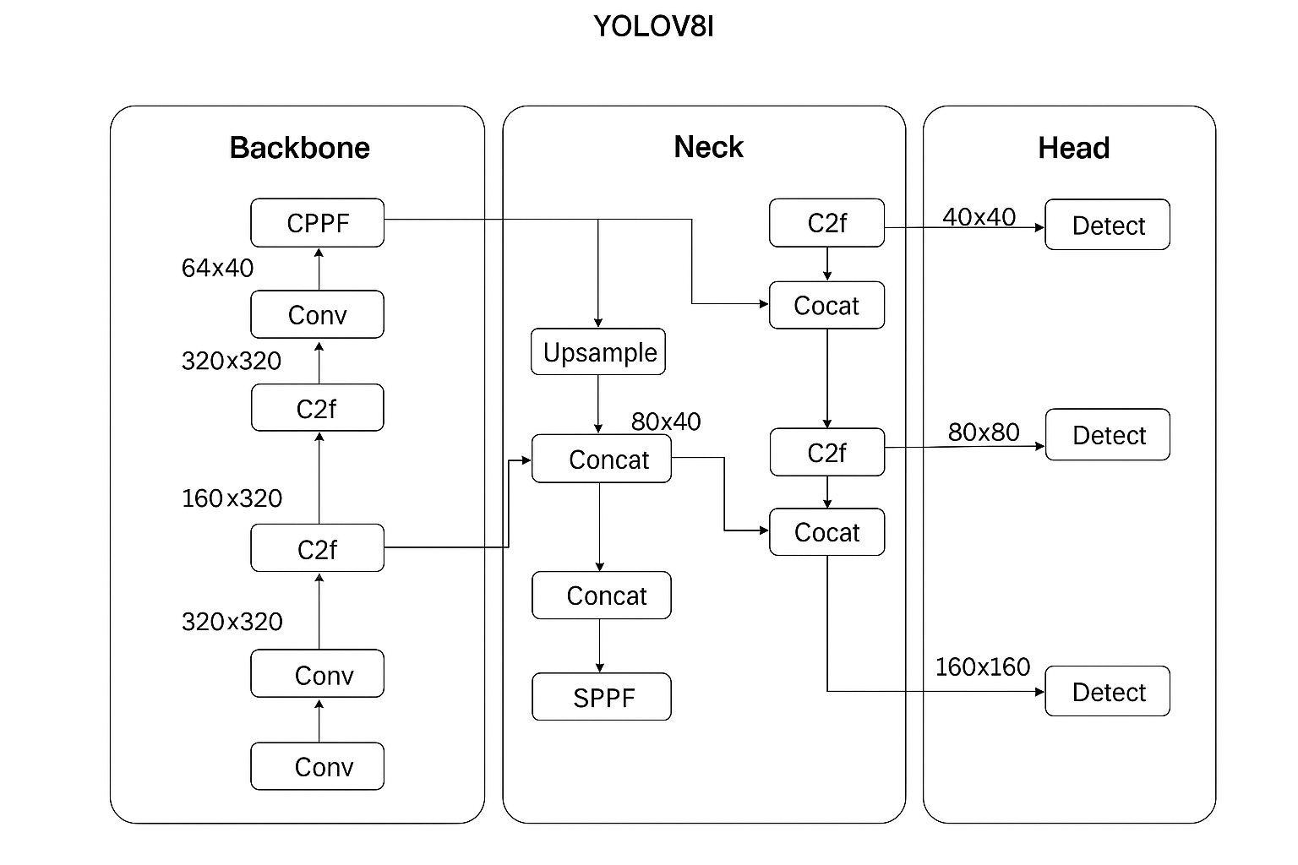
Research Scope
Model: YOLO v8-Large (55 Million Parameters) chosen for its high learning capacity.
Dataset: "Traffic and Road Signs" dataset containing 10,000 images and 29 distinct classes.
Application Domain: Computer Vision for Autonomous Driving and ADAS.
Architecture of YOLO v8l

Slide 7
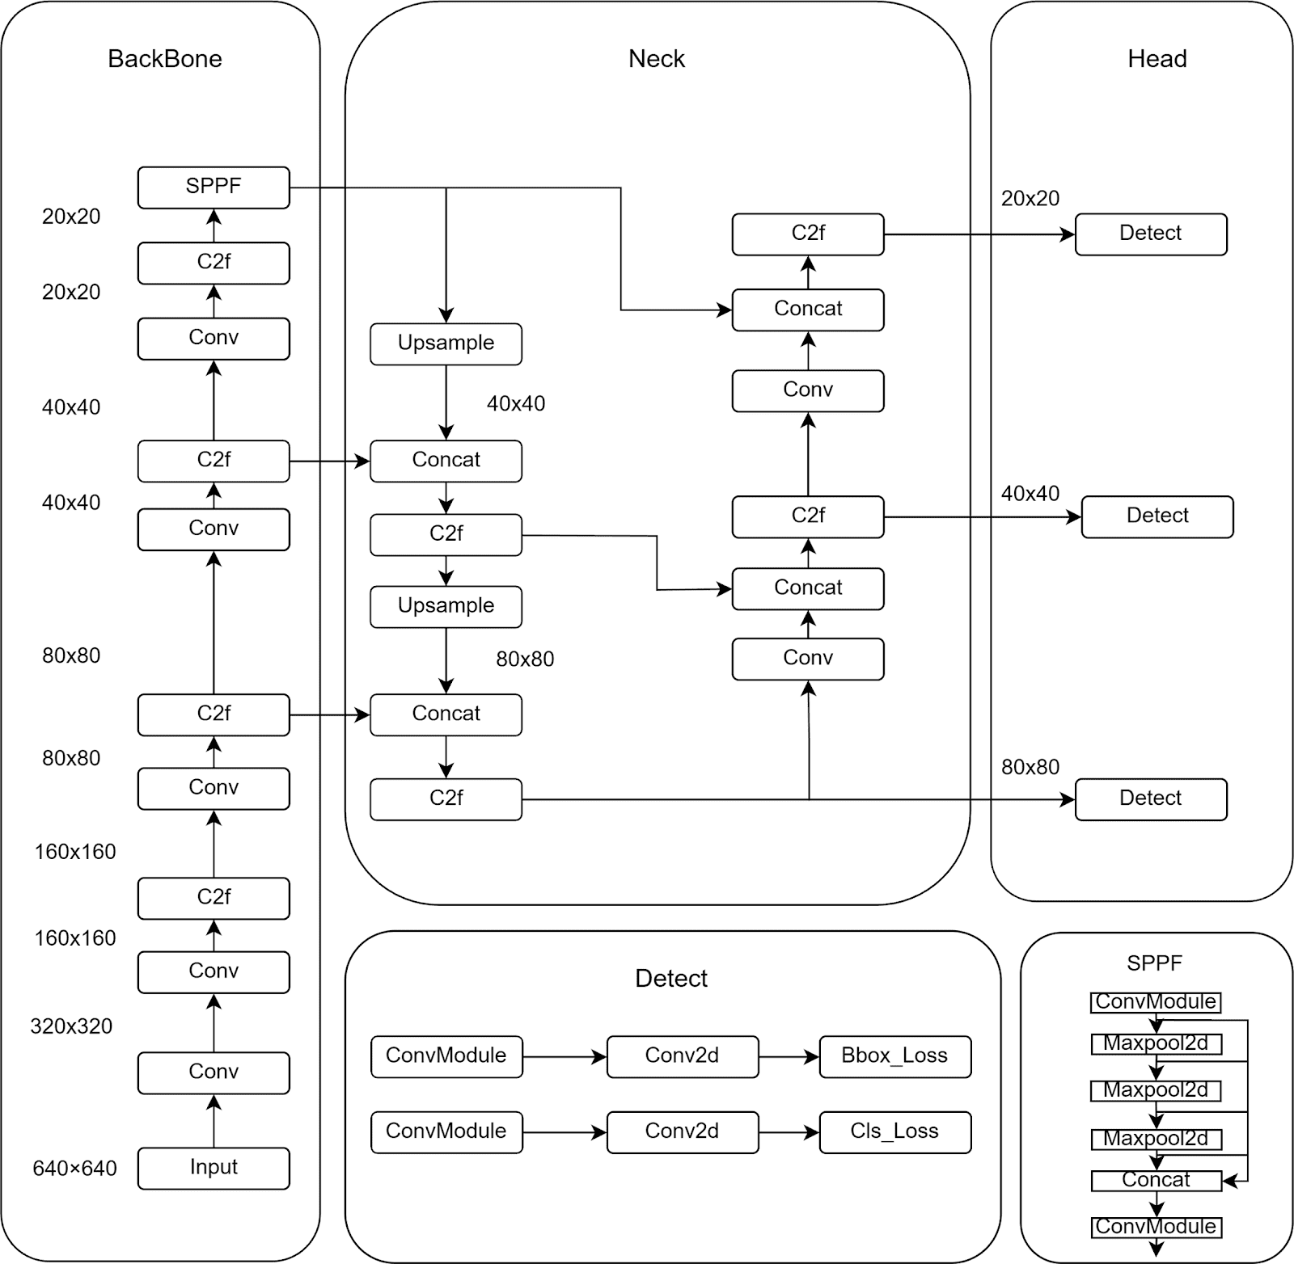
Literature Review
Traditional Methods: Color and shape-based algorithms were unreliable in complex real-world scenes .
Deep Learning Evolution:
R-CNN Family: Accurate but too slow for real-time driving .
YOLOv1-v5: Revolutionized speed and real-time detection .
YOLO v8 (Latest): Introduces Anchor-Free detection and the C2f module for better feature extraction.
YOLO v8 Network Architecture

Slide 8
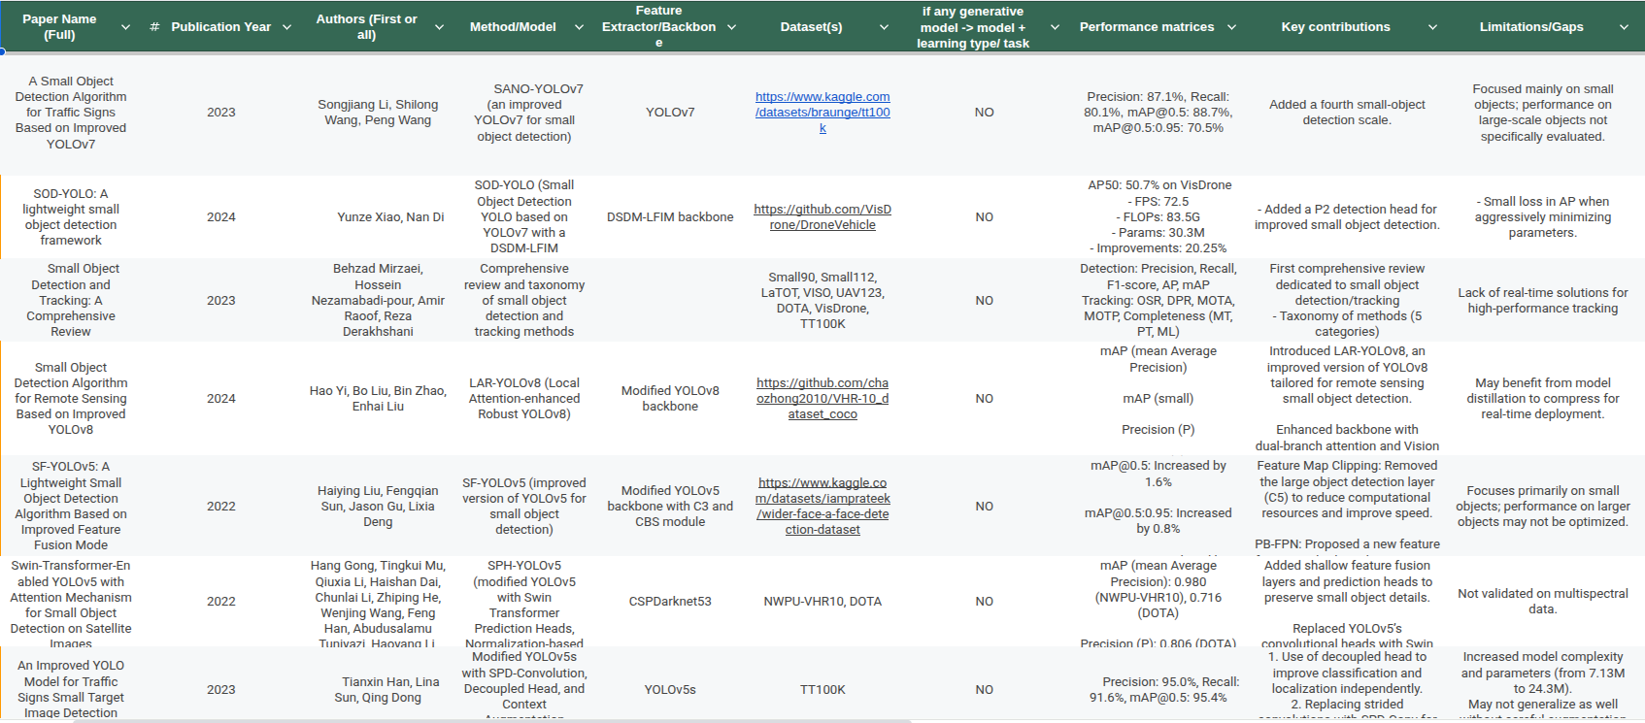
Literature Review

Slide 9
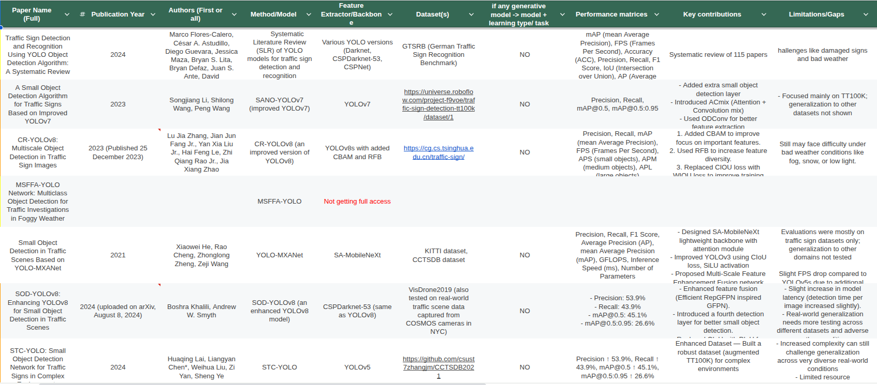
Literature Review

Slide 10
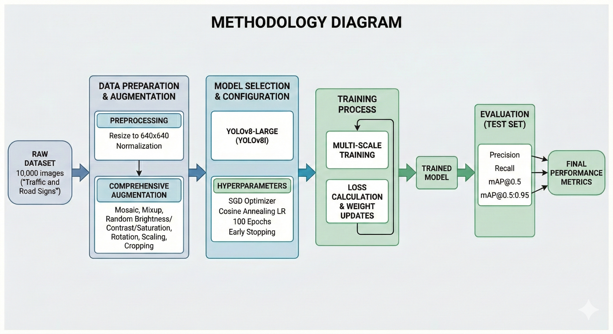
Methodology
Workflow Overview:
Dataset Preparation
→
Augmentation
→
Training (YOLO v8)
→
Evaluation.
Methodology Diagram

Slide 11
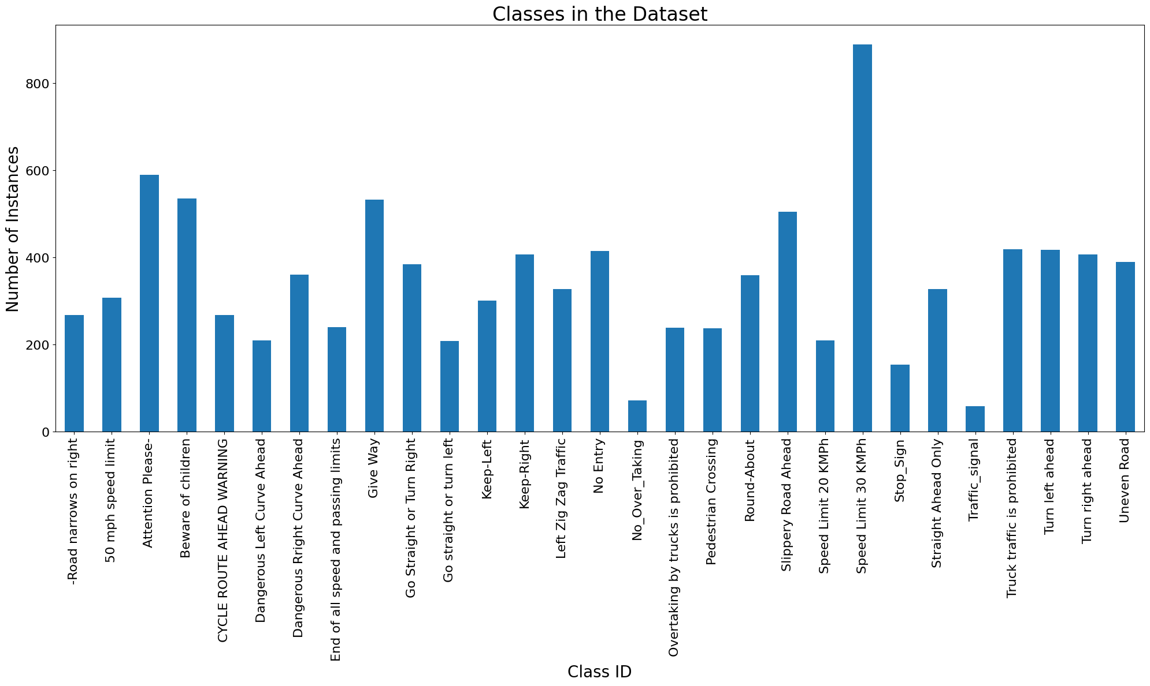
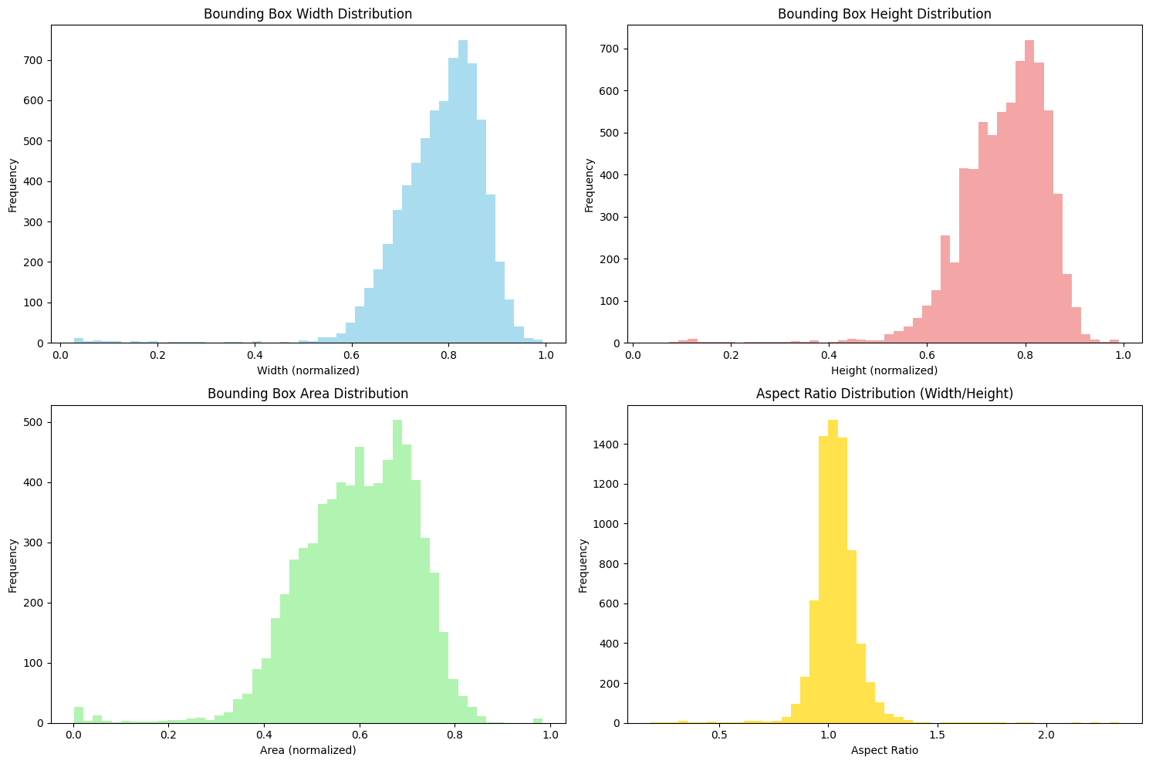
Dataset Overview
Data Source: 10,000 images from Roboflow "Traffic and Road Signs" dataset.
Classes: 29 distinct classes (e.g., Stop Sign, Speed Limit).
Diversity: Contains varying bounding box sizes and aspect ratios, ensuring the model learns to detect signs of all shapes.

Slide 12
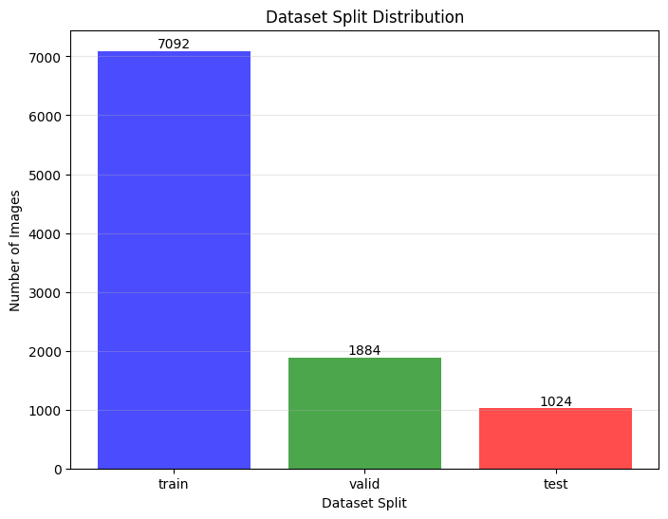
Data Preparation
Preprocessing: All images resized to 416 x 416 pixels.
Data Splitting:
Training: 71% (7,092 images)
Validation: 19% (1,884 images)
Testing: 10% (1,024 images) .

Slide 13
Comparison with State-of-Arts
Ablation Study Results:
Baseline (No Augmentation): Failed with only 42.10% mAP.
Proposed (Full Augmentation): Achieved 94.18% mAP.
Impact: A massive +52% improvement driven by our data-centric strategy.
External Comparison:
Competitive with recent studies on GTSRB (96.21%) and other YOLO v8 implementations (94.9%) .

Slide 14
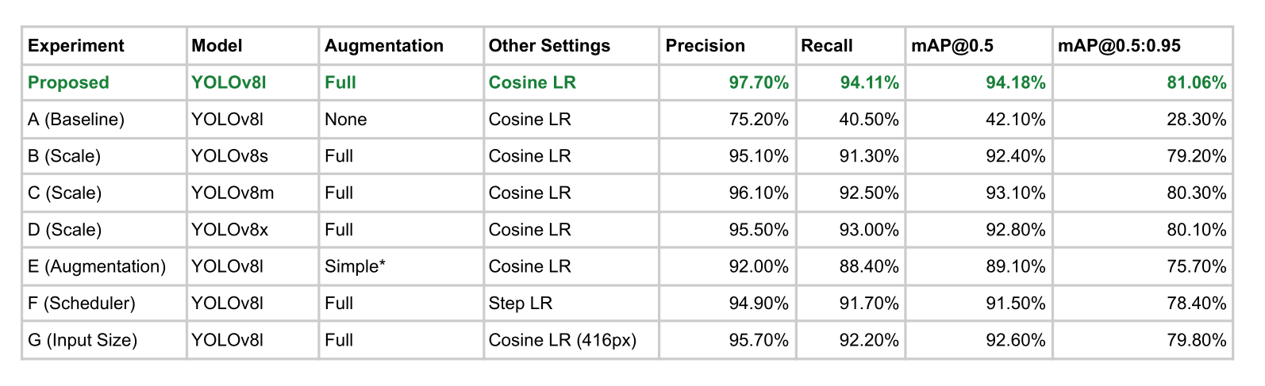
Ablation Study
Ablation Study Results :

Slide 15
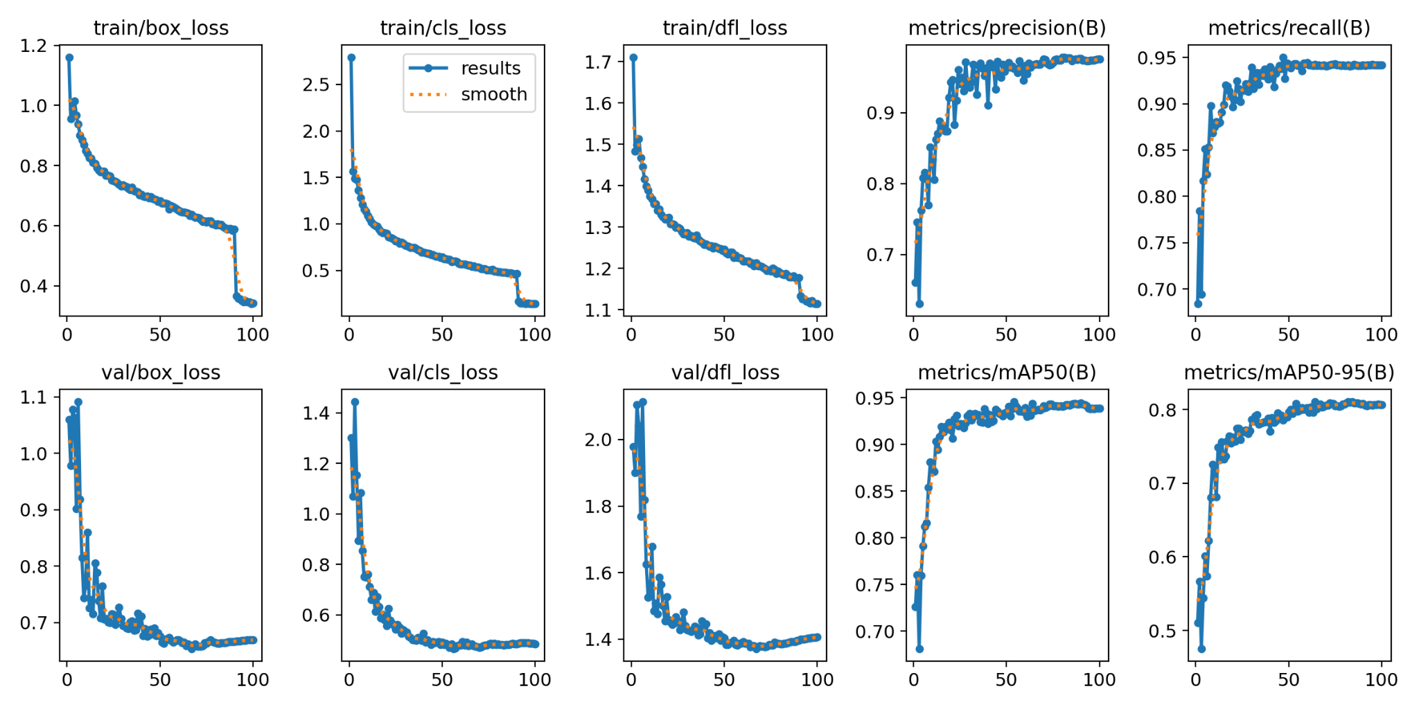
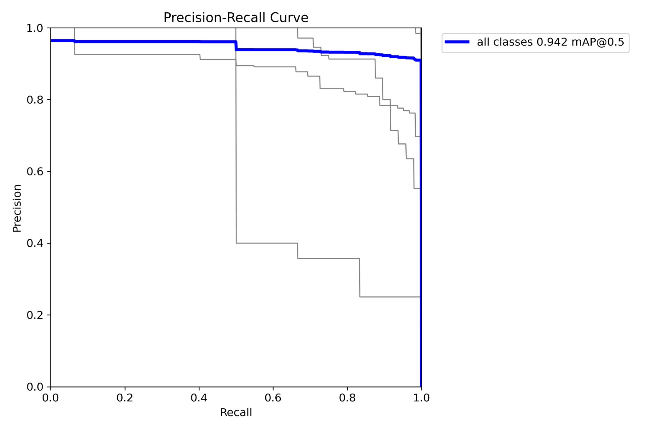
Results (Quantitative)
Final Test Metrics:
mAP@0.5: 94.18% (Excellent Detection).
mAP@0.5:0.95: 81.06% (High Precision Localization).
Precision: 97.70% | Recall: 94.11% .
Training Dynamics: Validation loss decreased consistently, proving no overfitting occurred.
Training Metrics
Precision-Recall Curve

Slide 16
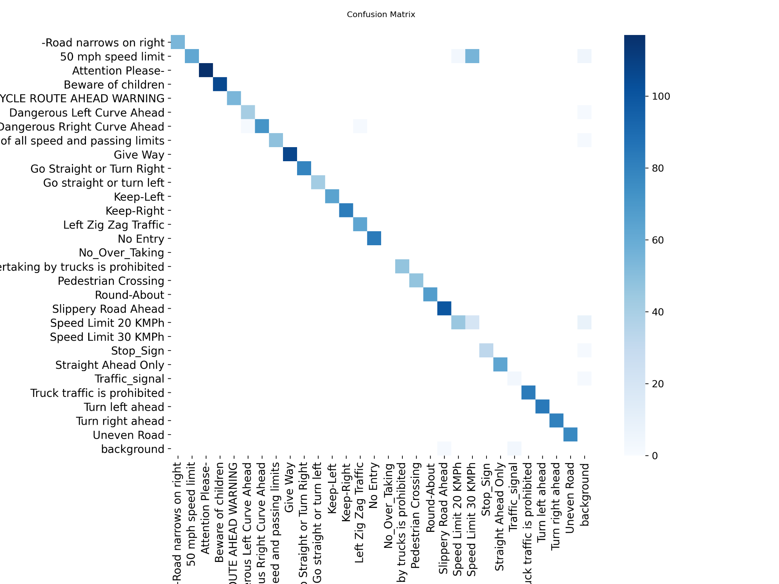
Results (Quantitative)
Class-wise Performance: The model shows high accuracy across nearly all 29 classes with minimal confusion.
Real-World Success: Successfully detects signs in low light, blur, and difficult angles.
Confusion Matrix

Slide 17
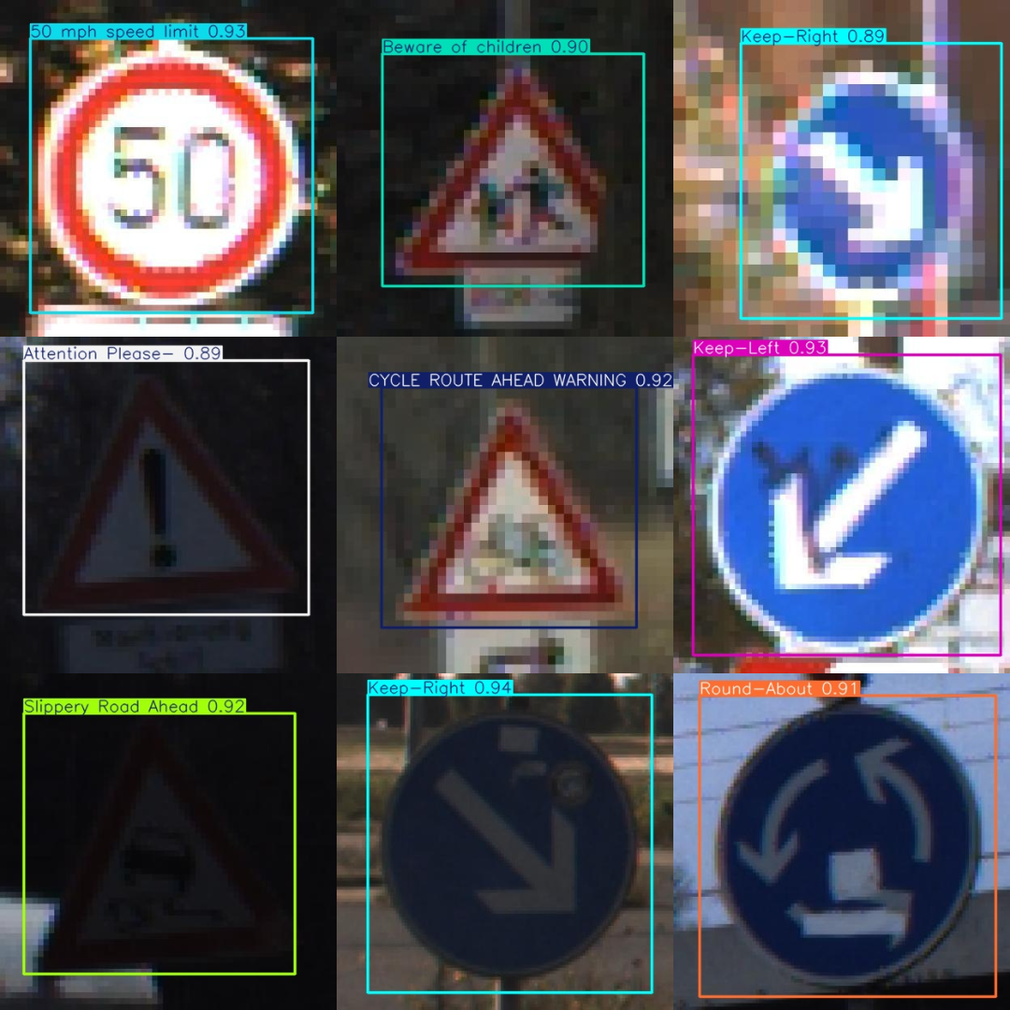
Conclusion
Successfully developed a high-accuracy traffic sign detection framework achieving 94.18% mAP.
Proved that a Data-Centric approach (robust augmentation) is just as critical as model architecture.
Demonstrated that the YOLO v8-Large model provides the necessary capacity to learn complex sign features compared to smaller models.
Provides a reproducible solution for safer autonomous vehicle systems.
Qualitative Detection Results

Slide 18
Future Work
Generalizability: I want to test this model on international datasets, like the German Traffic Sign Benchmark.
Small Objects: I will try new techniques like 'Attention Mechanisms' to see small signs even better.
Edge Deployment: I want to make the model smaller so it can run on small devices inside cars."

Slide 19
References
1.​ Flores-Calero, M.; Astudillo, C.A.; Guevara, D.; Maza, J.; Lita, B.S.; Defaz, B.;
Ante, J.S.; Zabala-Blanco, D.; Armingol Moreno, J.M. Traffic Sign Detection and
Recognition Using YOLO Object Detection Algorithm: A Systematic Review.
Mathematics 2024, 12, 297.
2.​ Mirzaei, B.; Nezamabadi-pour, H.; Raoof, A.; Derakhshani, R. Small Object
Detection and Tracking: A Comprehensive Review. Sensors 2023, 23, 6887.
3.​ Huang, Z.J.; Li, L.T.; Krizek, G.C.; Sun, L.H. Research on Traffic Sign Detection
Based on Improved YOLO v8. Journal of Computer and Communications, 2023,
11, 226-232.
4.​ Han, T.; Sun, L.; Dong, Q. An Improved YOLO Model for Traffic Signs Small
Target Image Detection. Appl. Sci. 2023, 13, 8754.
5.​ Zhang, L.J.; Fang, J.J., Jr.; Liu, Y.X., Jr.; Le, H.F.; Rao, Z.Q., Jr.; Zhao, J.X.
CR-YOLO v8: Multiscale Object Detection in Traffic Sign Images. IEEE Access,
2024, 12, 219-228.
6.​ Du, S.; Pan, W.; Li, N.; Dai, S.; Xu, B.; Liu, H.; Xu, C.; Li, X. TSD-YOLO: Small
traffic sign detection based on improved YOLO v8. IET Image Process. 2024, 18,
2884-2898.

Slide 20
Publication
Submitted Thesis:
Title: A Data-Centric Approach to High-Accuracy Traffic Sign Detection Using an Optimized YOLO v8 Model
Author: Piyash Basak
Institution: Daffodil International University
Dataset Link : https://universe.roboflow.com/usmanchaudhry622-gmail-com/traffic-and-road-signs/dataset/1

Slide 21
THANK YOU

Slide 22

Question ???

